Slide 1
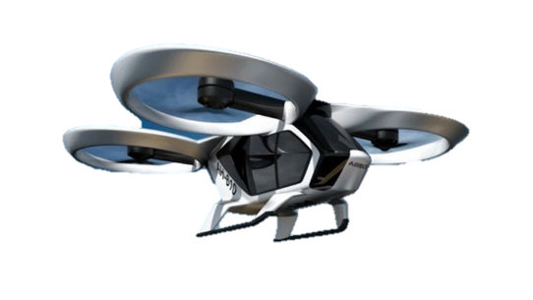
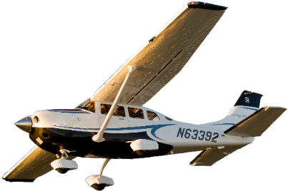
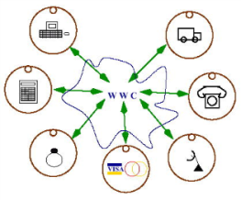

Conflict-Aware Flight Planning for Avoiding Near Mid-Air Collisions
SASWATA PAUL
STACY PATTERSON
CARLOS A. VARELA
DEPARTMENT OF COMPUTER SCIENCE
Rensselaer Polytechnic Institute
The 38th DASC, San Diego – September 2019

Slide 2

Motivation
The future of National Airspace System

Slide 3
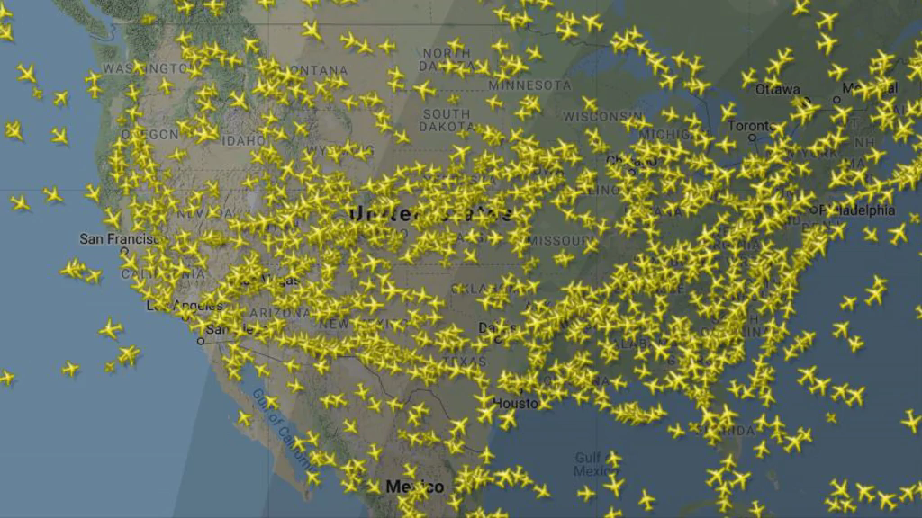
Motivation
Urban Air Mobility
5000 aircraft in the sky at peak operational times
Loss of standard separation increased by 10.6% in 2017
Expected to increase with the inclusion of UAS in the NAS
Current Air Traffic Control
Not scalable
Centralized (518 ATC towers)
Not formally verifiable
Prone to human errors
Video created using images from www.flightradar24.com

Slide 4
Motivation
Errors are catastrophic
1st July 2002, a Tu-154 and a Boeing 757 cargo jet collided in Überlingen
Both aircraft crashed – 69 fatalities
29th Sept. 2006, Gol Transportes Aéreos 1907 collided with a business jet
The Boeing 737-8EH crashed – 154 fatalities
16th Aug. 2015, a C172 and a Sabreliner 60SC collided near San Diego
The Cessna was destroyed – 5 fatalities
Investigations indicated ATC error in all cases
Need for
Decentralized, scalable, and smarter air traffic management
Provably correct strategic conflict management

Slide 5
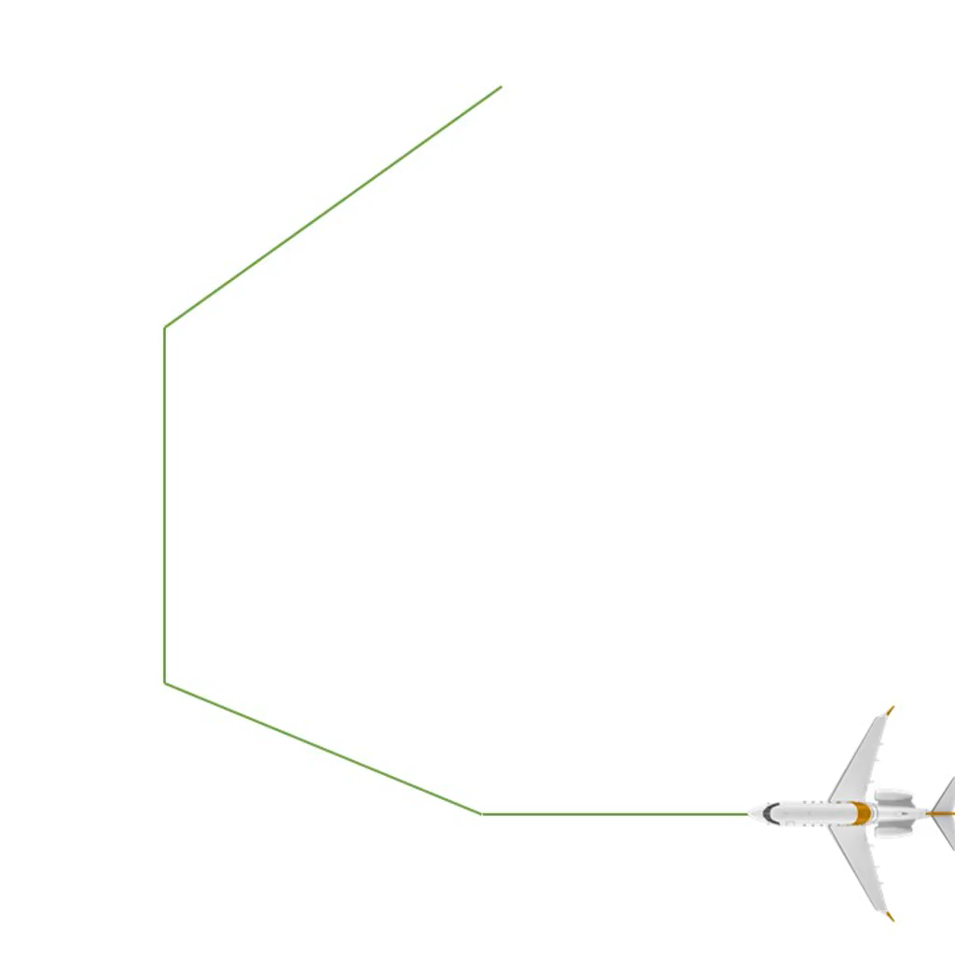
Conflict-Aware Flight Planning
Goal: To create a formally-verified flight planning algorithm that can ensure standard separation between an ownship and traffic aircraft following a given set of flight-plans.
Flight-plan:
a series of waypoints in 3D space
a start time
constant groundspeed and vertical speed between
consecutive waypoints
We have used the Athena proof assistant to mechanically verify that our algorithm generates safe solutions

Slide 6
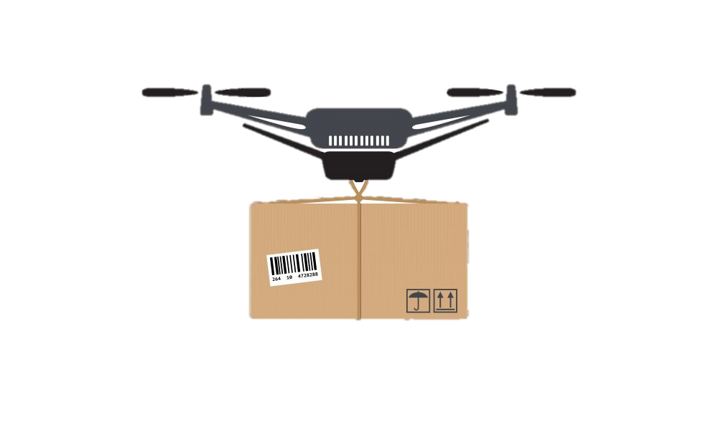
Novelty
The solution flight-plans generated do not consist of spatial deviations
Useful for situations where spatial deviation may be restricted by weather, airspace capacity, or restricted airspace
Suitable for civilian use of UAS in urban environments
Formally verified to detect and resolve conflicts between entire flight-plans
Temporal dimension divided into periods of interest for conflict detection in multiple flight segments

Slide 7
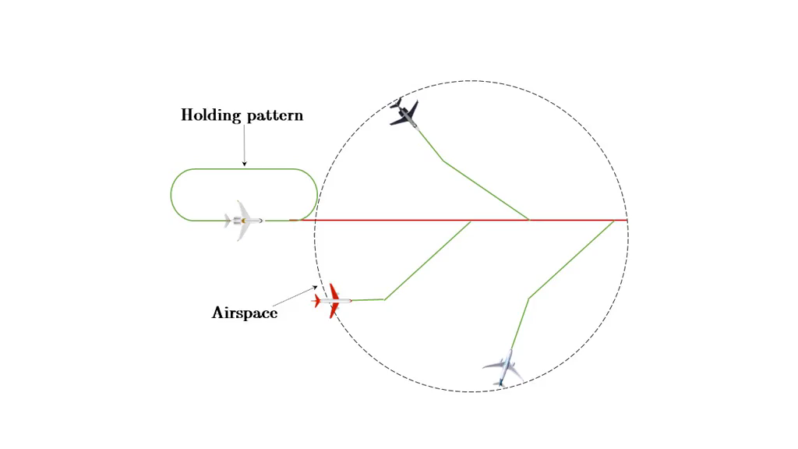
Novelty
May be used by a centralized/decentralized controller for admission control into an airspace

Slide 8
CAFP Algorithm
INPUTS:
A proposed flight-plan for an ownship
A set of immutable traffic flight-plans
A vector of discrete values of airspeed
The horizontal wind data
Output:
A valid flight-plan for the ownship (if possible)
Only the groundspeed and vertical speed between waypoints is changed
3D flight profile unchanged

Slide 9
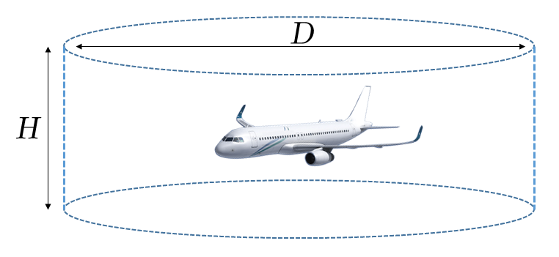
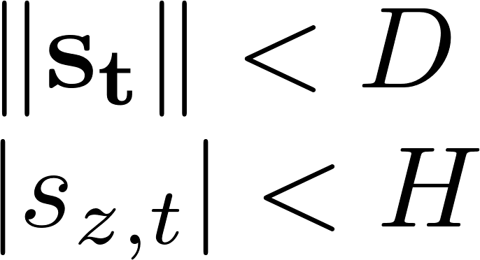
Conflict Between Two Flight-plans
The well-clear volume [Lee et al.]
a cylinder of diameter D and height H around the center of the aircraft
two aircraft are in conflict if their well-clear volumes intersect

Slide 10
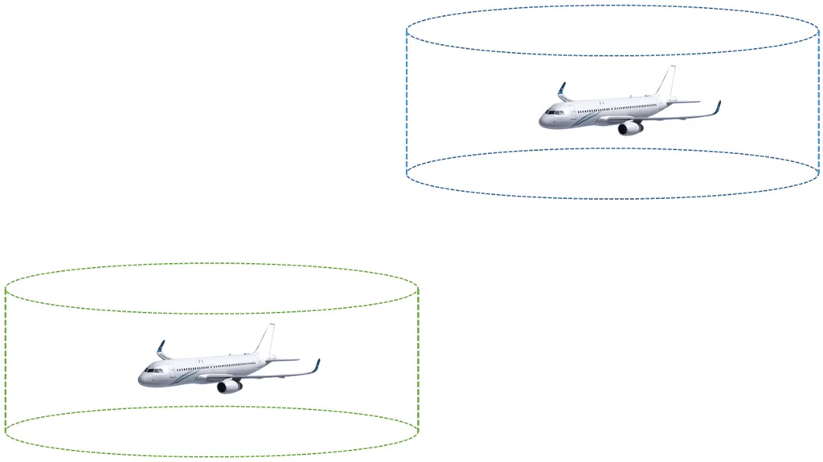
Conflict Between Two Flight-plans

Slide 11
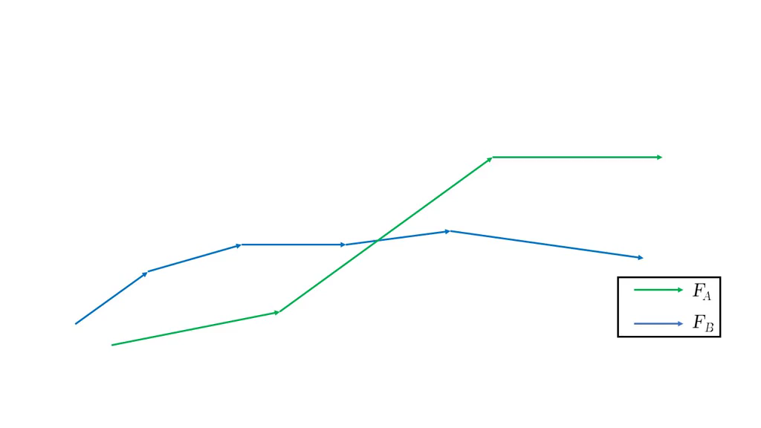
Conflict Between Two Flight-plans
However, this is true only under the assumption that both aircraft a and b maintain constant velocity flight between t₀ and t
Flight-plans may be a sequence of multiple constant velocity flight segments
To predict conflicts between two
flight-plans, we need to discretize
the temporal dimension into
periods of interest
Notes:
“Velocity” is correct here since both groundspeed and vertical speed remain constant in a flight segment

Slide 12
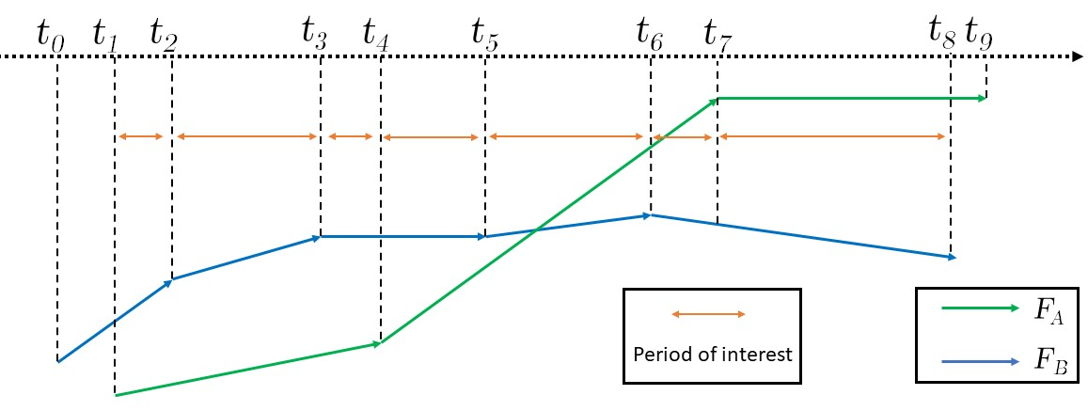
Conflict Between Two Flight-plans
Period of interest - a period of time when both aircraft are known to maintain constant velocity flight
Given two flight-plans, a non-decreasing vector T of temporal points corresponding to the waypoints in each flight-plan can be computed
The period between each consecutive temporal point in T is a period of interest
Notes:
Static image available on

Slide 13
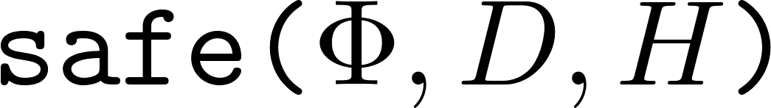


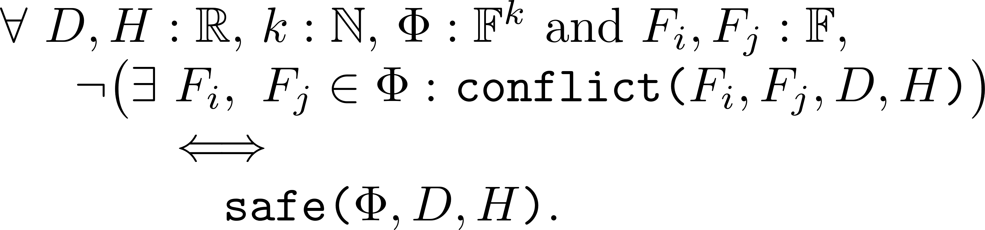
Conflict Between Multiple Flight-plans
Input: A set of flight-plans , the horizontal and vertical thresholds D and H
Output: FALSE if there exists a possible conflict between any F_{i} and F_{j} . TRUE otherwise.
THEOREM 4:

Slide 14
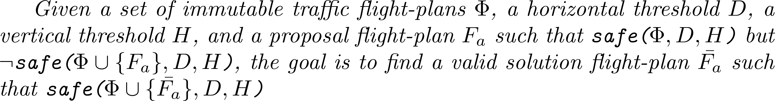
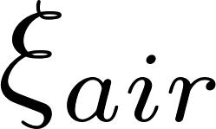

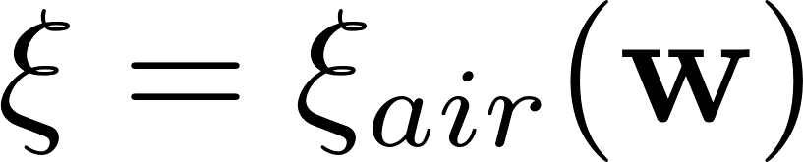
Conflict Aware Flight-planning
The problem statement:
The strategy:
To resolve possible conflicts between an ownship a and a traffic aircraft b, we assign suitable values of constant groundspeed between consecutive waypoints in the ownship’s flight-plan
Given a vector of allowed airspeeds for the ownship and the wind vector , a vector of possible groundspeeds can be computed

Slide 15
Conflict Aware Flight-planning
The strategy (contd.):
To retain the 3D profile of the proposed flight-plan, the constant vertical speed between waypoints needs to be adjusted accordingly
This pairwise strategy is extended to the set to find a solution such that
Only two components of the velocity vector between waypoints are altered:
The groundspeed
The vertical speed
The 3D course between waypoints remains unchanged

Slide 16
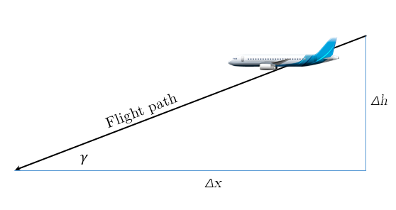
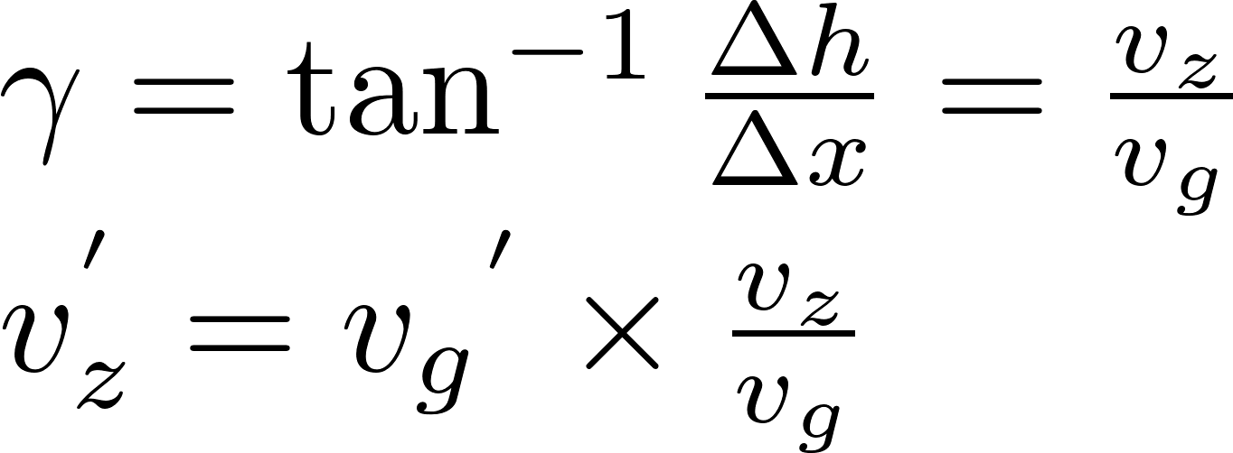
Adjusting the Vertical Speed
The new vertical speed can be computed using the flight path angle

Slide 17
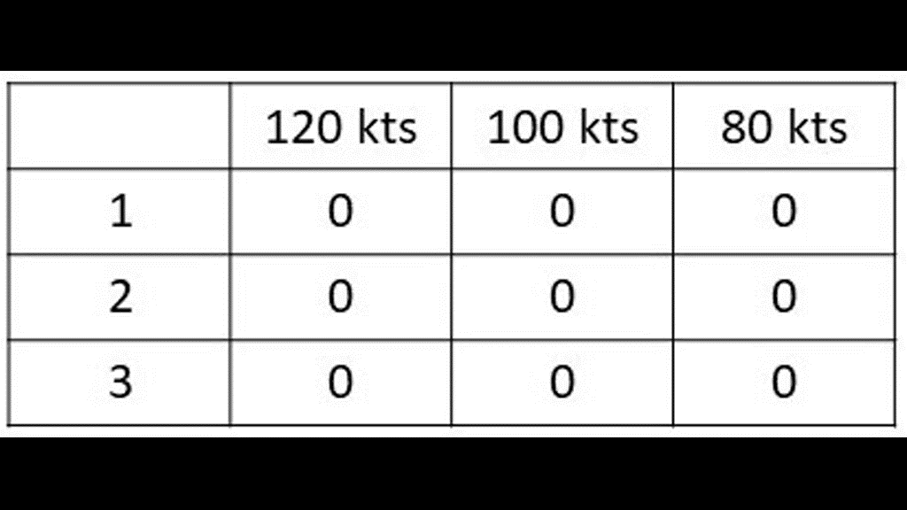

Computing the Groundspeed Assignments
The assignment of groundspeed to the flight segments between waypoints can be arranged as an m x n matrix
m = (number of waypoints - 1)
n = number of possible
groundspeeds
Initially, all cells are 0 (M₀)
The cell M[r,c] is assigned a 1 if the r^{th} segment is assigned the c^{th} element of

Slide 18
Computing the Groundspeed Assignments
Required properties:
Safety Property – If a matrix is generated by the algorithm, then adding the corresponding flight-plan to the given set of traffic flight-plans must create a safe set of flight-plans
Completeness Property – If there is a combination of groundspeeds that can create a solution flight-plan, the algorithm will not return M₀.

Slide 19
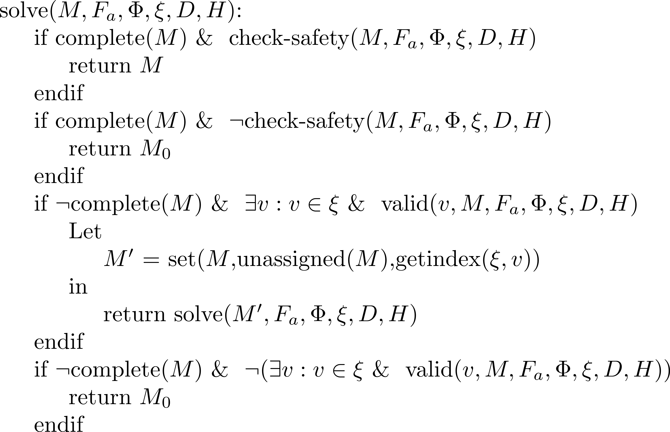
The Matrix Assignment Algorithm
The solve() function computes the solution matrix:

Slide 20
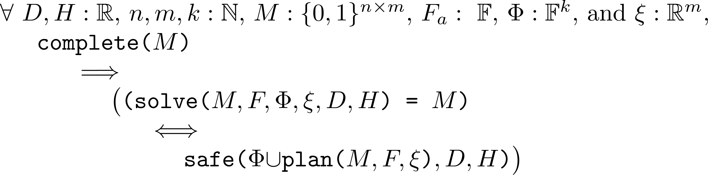
The Matrix Assignment Algorithm
Input: An assignment matrix , the proposed flight-plan, the set of traffic flight-plans, the vector of groundspeeds, and the thresholds D and H
Output: Returns a complete assignment matrix if a valid solution can be found. Otherwise, returns M₀
THEOREM 8:
Theorem 8 corresponds to the Safety Property

Slide 21
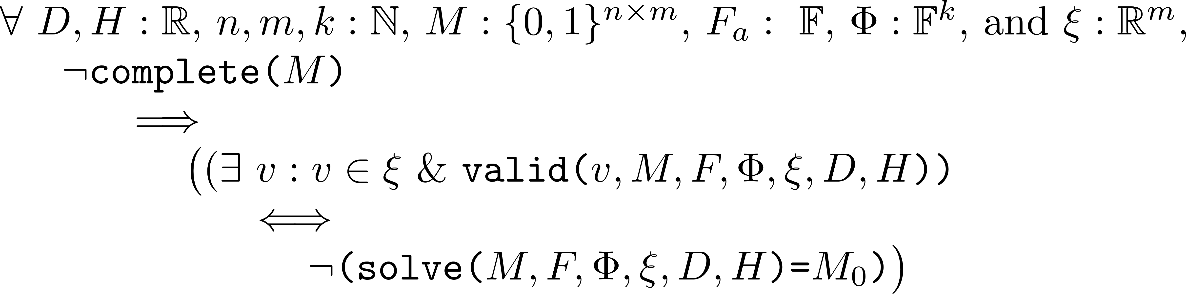
The Matrix Assignment Algorithm
THEOREM 9:
Theorem 9 corresponds to the Completeness Property
Both these Theorems have been proven in Athena
* Proofs available at: http://wcl.cs.rpi.edu/pilots/fvcafp

Slide 22
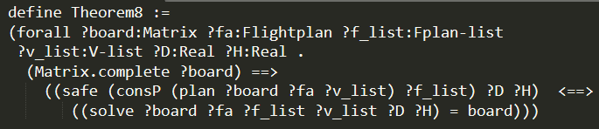
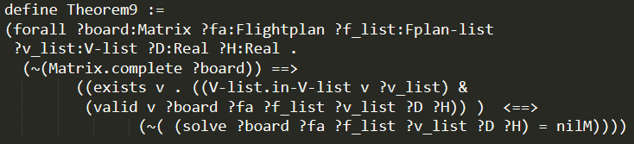
The Matrix Assignment Algorithm
The theorems in Athena :

Slide 23
Simulations
A proof of concept implementation was developed using Python
The implementation closely followed the Athena specifications
We used D = 1 nautical miles and H = 1000 feet
All flight-plans were at a constant altitude of 5000 feet
The wind velocity used was 0 kts

Slide 24
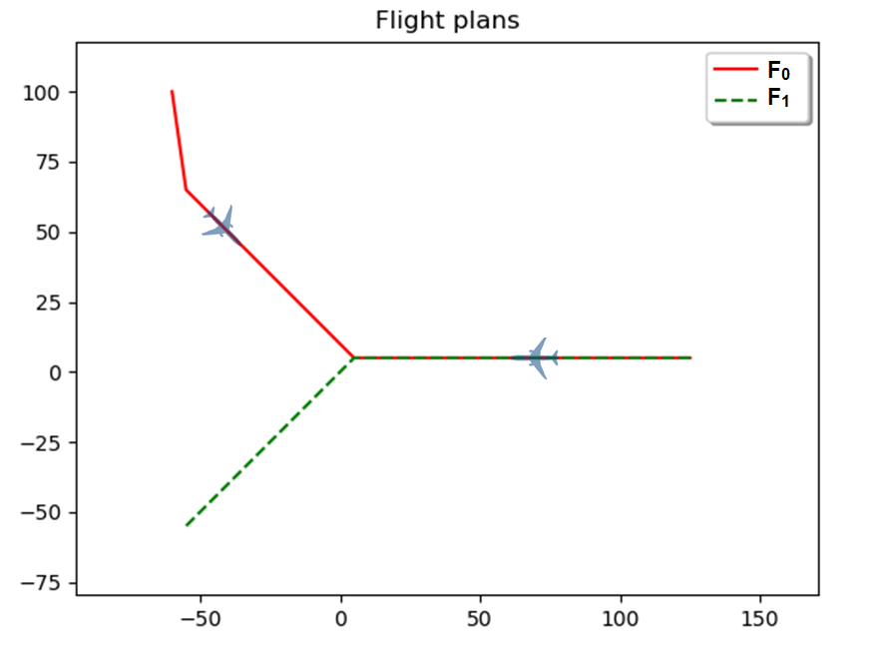
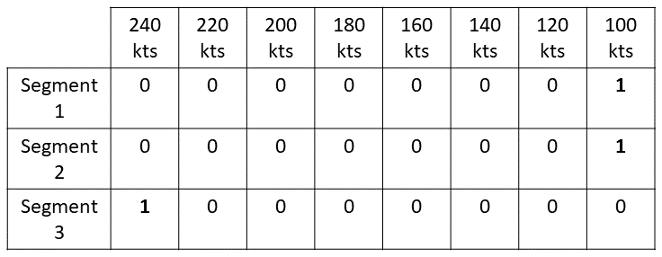
Simulations
First Scenario:
F₀ and F₁ were in conflict and our algorithm computed a solution assignment matrix

Slide 25
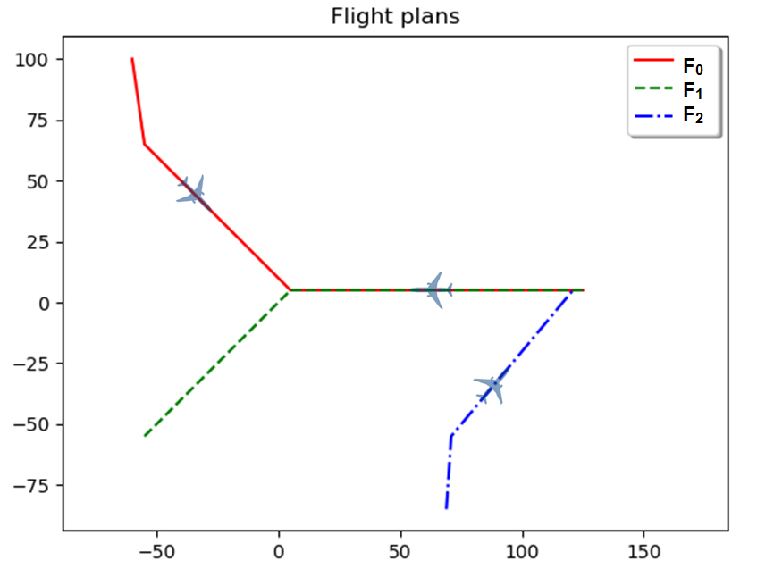

Simulations
Second Scenario:
A third plan F₂ was introduced, and our algorithm computed a solution assignment matrix

Slide 26
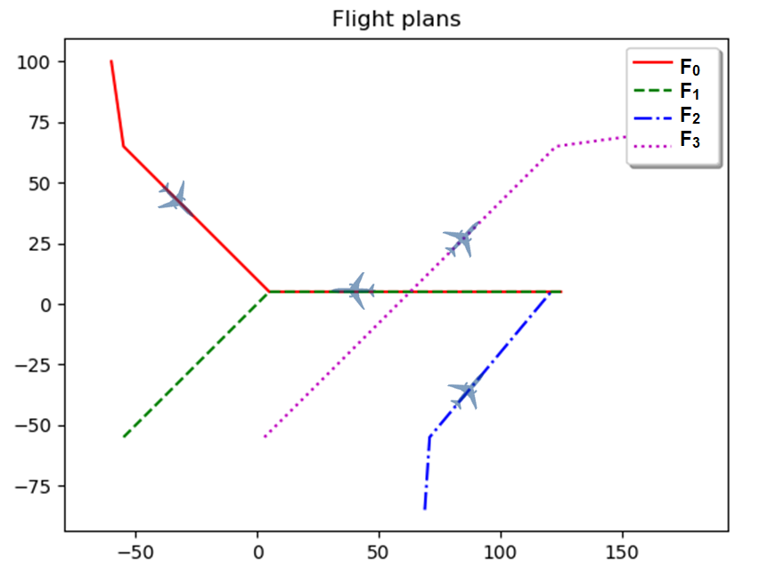

Simulations
Third Scenario:
A fourth plan F₃ was introduced, but there was no possible solution, so the algorithm returned M₀

Slide 27
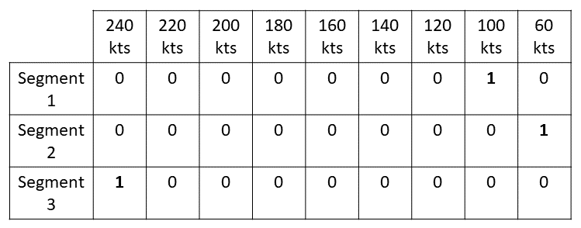
Simulations
Third Scenario (augmented ):
We added a groundspeed of 60 kts to the vector of groundspeeds and a solution was found

Slide 28
Observations
The algorithm can be effectively used to detect possible well-clear violations and compute solutions
The airspace density makes a significant impact on the availability of solutions
The range of values in also plays an important role
Since , the wind conditions can be expected to considerably influence the solution space as well

Slide 29
Discussion
Advantages:
Formally verified strategic conflict avoidance
Discretizing time into periods of interest allows conflict detection and avoidance for multi-segment flight-plans
No spatial deviation from the proposed flight-plan
Useful in terminal STARs and urban environments which provide little room for spatial deviation (civilian applications of UAS such as package delivery)
Limitations:
Limited solution space may not always lead to a solution
The assumption that traffic aircraft do not deviate from their flight-plans may not always be true
Do not consider other options – up/down/left/right/holding maneuvers

Slide 30
Discussion
Related Work:
Muñoz et al. - formally verified tactical collision avoidance
Tactical avoidance does not deal with entire flight-plans
Spatial deviation from flight path
Balachandran et al. – used RAFT consensus for scheduling UAVs approaching an intersection
New waypoints to maximize arrival times
Spatial deviation may not always be possible in urban environments

Slide 31
Concluding Remarks
The future of the NAS:
Significant challenges in terms of air-traffic management
ADS-B can be made a richer source of data for real-time tracking and conflict-management
Smarter air traffic management protocols required to deal with high density of aircraft
Future directions of work:
Algorithm that relaxes the condition that traffic flight-plans are immutable
Cooperative protocols where all aircraft reach a mutual agreement on a single set of allowed flight-plans

Slide 32

Questions?
Download open-source PILOTS at:
http://wcl.cs.rpi.edu/pilots
Partial support from:
Air Force Office of Scientific Research
DDDAS Program
Dr. Frederica Darema & Dr. Erik Blasch
(AFOSR Grant No. FA9550-19-1-0054, FA9550-15-1-0214, FA9550-11-1-0332),
National Science Foundation
(NSF Grant Nos. - CNS 1816307, ECCS 1462342)
Consider textbook:
MIT Press, June 2013

Slide 33
Extra Slides

Slide 34
Background – Cyber Physical Systems
To facilitate development of smarter flight systems, we have previously investigated:
PILOTS (ProgrammIng Language for spatiO-Temporal data Streaming applications)
Error detection using error signatures and error correction based on data redundancy
Machine learning techniques to infer
relationships from aircraft sensor data
offline supervised training
online prediction and learning
Trajectory Generation for Fixed-Wing Aircraft in LOT Emergencies
Wind-aware trajectories in the presence of constant, horizontal wind
Possible landing options for US Airways 1549

Slide 35
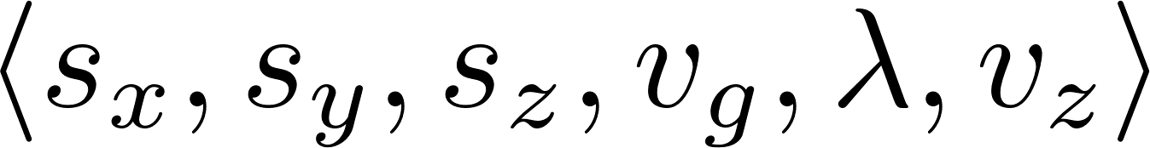
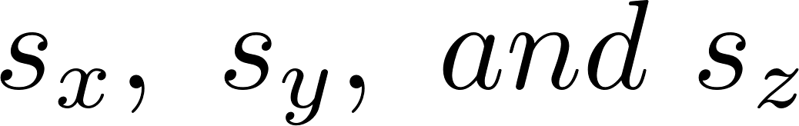

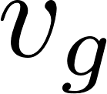
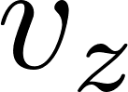
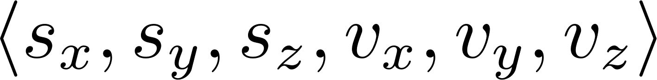
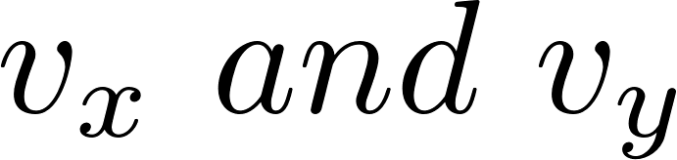
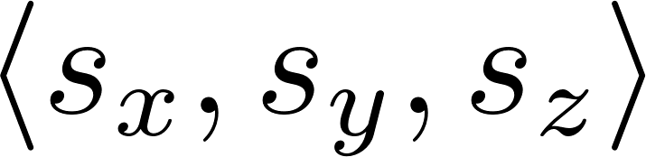
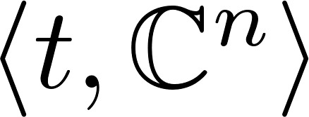
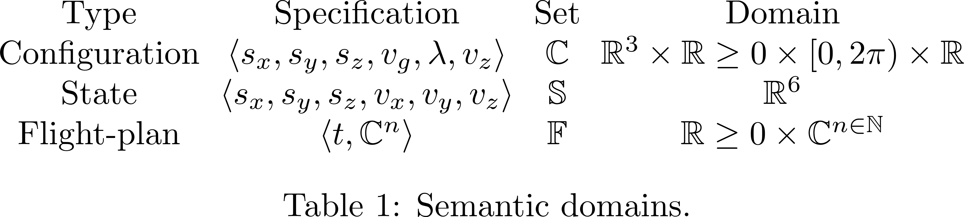
Definitions
Configuration – A vector where are the components of the position vector, is the course, is the groundspeed, and is the vertical speed of an aircraft.
State – A vector where the components of the ground-speed are
Waypoint – A vector which represents the 3D position of an aircraft in the coordinate space
Flight-plan – A vector containing a starting time and a vector of n configurations representing n waypoints

Slide 36
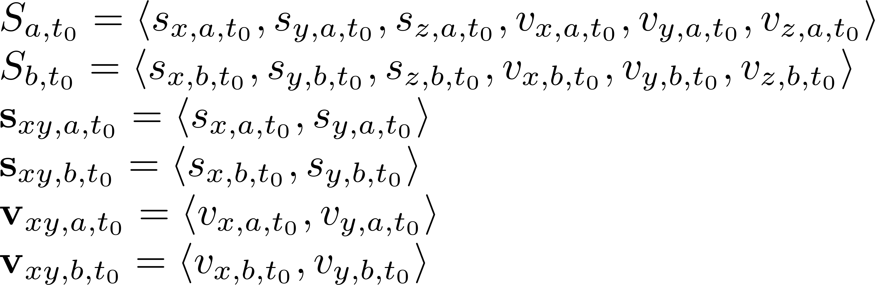
Conflict Between Two Flight-plans
Given the states of two aircraft at time t₀ , their 2D position and velocity vectors can be computed:
Their relative position and velocity at time t₀ can be computed as:

Slide 37
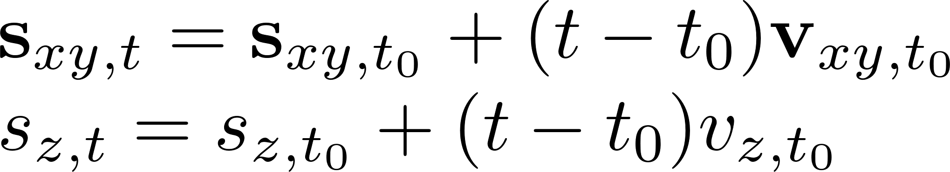
Conflict Between Two Flight-plans
Assuming that both aircraft maintain constant velocity flight, their relative position and velocity at time t >= t₀ can be computed:
The well-clear volume of an aircraft is defined as a cylinder of diameter D and height H around the center of the aircraft.

Slide 38
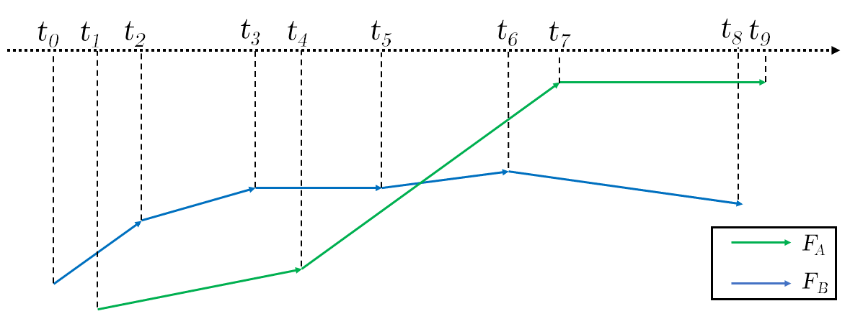
Conflict Between Two Flight-plans
Period of interest - a period of time when both aircraft are known to maintain constant velocity flight
Given two flight-plans, a non-decreasing vector T of temporal points corresponding to the waypoints in each flight-plan can be computed
The period between each consecutive temporal point in T is a period of interest

Slide 39
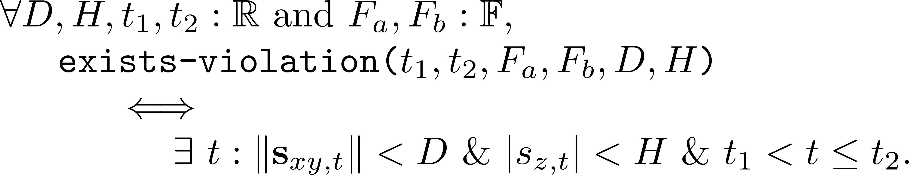
Conflict Between Two Flight-plans
Some important functions:
Input: initial and final times t₁ and t₂ for a period of interest, two flight-plans F_{a} and F_{b} , the horizontal and vertical thresholds D and H
Output: TRUE if there exists a time t between t₁ and t₂ such that there is a possible intersection of the well clear volumes. FALSE otherwise.
THEOREM 1:

Slide 40
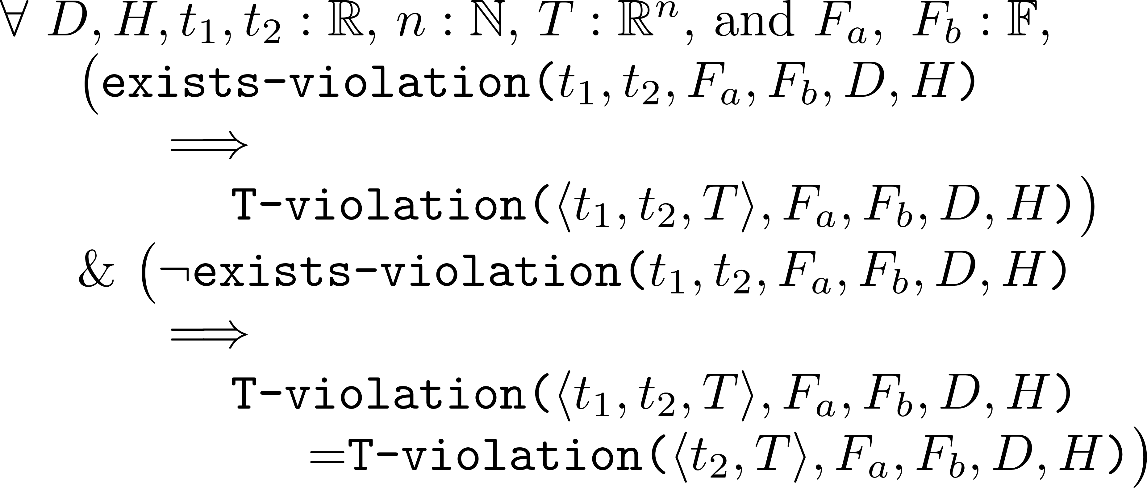
Conflict Between Two Flight-plans
Input: A vector of times T, two flight-plans F_{a} and F_{b} , the horizontal and vertical thresholds D and H
Output: TRUE if there exists a possible intersection of the well clear volume between any two consecutive elements of T.
THEOREM 2:

Slide 41
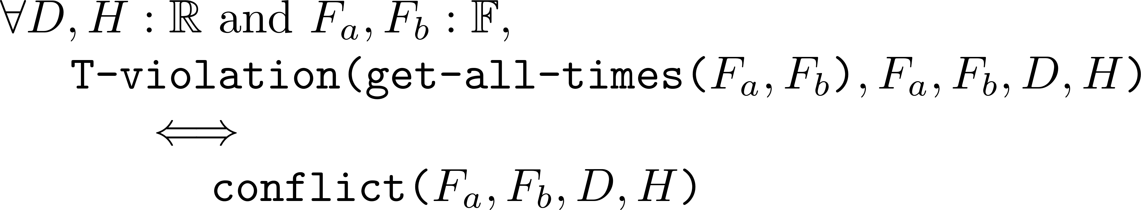
Conflict Between Two Flight-plans
Input: Two flight-plans F_{a} and F_{b} , the horizontal and vertical thresholds D and H
Output: TRUE if there exists a possible intersection of the well clear volume between F_{a} and F_{b}. FALSE otherwise.
THEOREM 3:

Slide 42

Conflict Aware Flight-planning
The problem statement:
The strategy:
Let F_{b} be a flight-plan in
If F_{a} and F_{b} are in conflict, there is a time t :
To resolve this conflict, the ground-speed between the waypoints of F_{a} can be changed to prevent any violations of the horizontal threshold
Given a vector of allowed airspeeds for the ownship and the wind vector , a vector of possible ground-speeds can be computed.
To retain the 3D profile of the proposed flight-plan, the vertical speed between waypoints need to be adjusted accordingly

Slide 43
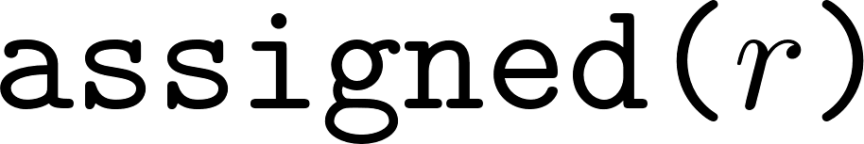
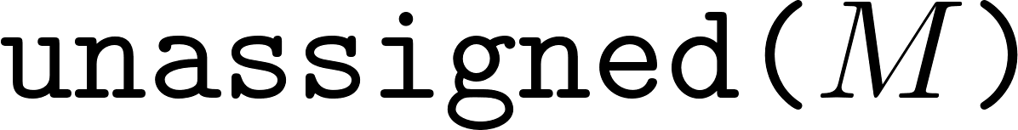

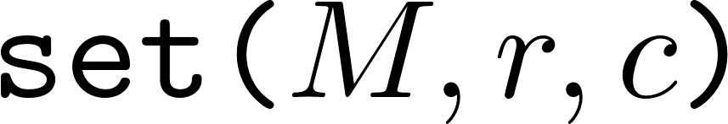
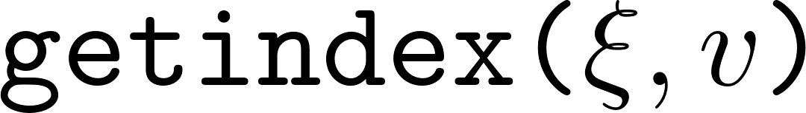
The Matrix Assignment Algorithm
Some more functions:
returns TRUE iff the r^{th} row has been assigned a 1
returns the first unassigned row of M
returns an intermediate flight-plan corresponding to the assignment matrix M
sets 1 to the cell M[r,c]
returns the index of a value in the ground-speed vector

Slide 44
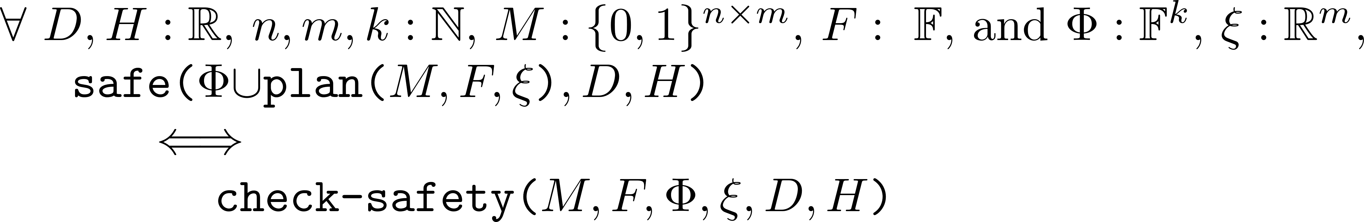
The Matrix Assignment Algorithm
Input: An assignment matrix , the proposed flight-plan, the set of traffic flight-plans, the vector of ground-speeds, and the thresholds D and H
Output: TRUE iff the intermediate flight-plan corresponding to the assignment matrix is safe.
THEOREM 5:

Slide 45


The Matrix Assignment Algorithm
Input: An assignment matrix
Output: TRUE iff all the rows have been assigned a ground-speed.
THEOREM 6:

Slide 46

The Matrix Assignment Algorithm
Input: A value of ground-speed, an assignment matrix , the proposed flight-plan, the set of traffic flight-plans, the vector of ground-speeds, and the thresholds D and H
Output: TRUE iff the value can be safely assigned to the first unassigned row of the assignment matrix.
THEOREM 7:

Slide 47
Dynamic Data Driven Avionics
Our Goal: To create a dynamic data driven trajectory generation system to assist pilots in such situations by taking into consideration dynamic aspects such as partial power, wind, etc.
Our model uses geometric criteria for generating trajectories using different bank angles and corresponding radii of turn and glide ratios for different drag configurations.
Our aircraft model is parameterized on a Baseline Glide Ratio for clean aircraft configuration assuming best gliding airspeed in straight flight.
We dynamically infer the baseline glide ratio to update our model in order to accurately reflect the current performance of the aircraft.

Slide 48

Simulations

Slide 49


Dynamic Data Driven Model
Fig: Dynamic Data Driven Flight Trajectory
Generation
Fig: Damaged Aircraft Model

Slide 50


Low-altitude trajectories
For a given runway and a given bank angle, we have two scenarios:
Low Altitude scenario:
In this case, the trajectory consists of a simple Dubins Airplane Path that brings the aircraft to the runway.

Slide 51
High-altitude trajectories
High Altitude scenario:
When a simple Dubins Airplane Path brings the aircraft too high above the runway.
We find an intermediate point to lose excess altitude by extending the final approach along the runway heading.
In this case, the trajectory consists of:
A simple Dubins Airplane Path to bring the aircraft over the runway
An integral [0,1,2….] number of spiral turns to lose excess altitude
An Extended Runway of length X ∈ [0, 2πR g/g₀ ) if integral number of turns cannot bring the aircraft down to the runway at proper altitude.
A landing configuration glide ratio and airspeed is assumed for the extended runway segment.

Slide 52


High-altitude trajectories
High Altitude Scenario where number of spirals > 0

Slide 53


High-altitude trajectories
High Altitude Scenario where number of spirals = 0

Slide 54

Extended Runway Segment
We use a dirty (landing) configuration glide ratio in the extended runway segment to make sure that the starting point of this segment is at an altitude from which the aircraft can make it safely to the runway.

Slide 55
Trajectory Safety Metrics
We introduce safety metrics to evaluate trajectories.
Evaluation of trajectories makes it possible for a pilot to make a better informed choice in a shorter time.
The Metrics are:
Average altitude
Average distance from runway
Average bank angle over height
measures the occurrence of steep turns near the ground
Total time
Extended final runway segment distance
Number of turns

Slide 56
Trajectory Safety Metrics
Each metric is normalized relative to the minimum or maximum (whichever is desired) and then evaluated in our safety metric equation
We introduce an Utility Function computed by taking a weighted average of all the metrics
This Utility Function is then used to rank the trajectories generated according to their – higher value of utility function implies better trajectory and a better rank
The utility function can be easily modified to account for other factors like Wind

Slide 57


Effect of Wind on Trajectories
Wind has a profound impact on the shape of flown trajectories with respect to the ground.
Effect of wind on straight flight Effect of wind on turns

Slide 58


Effect of Wind on Trajectories
In the presence of wind, turns have ground-tracks that are trochoidal rather than circular.
Straight line flights create ground-tracks that are different (have a crab angle).

Slide 59

Effect of Wind on Trajectories
Therefore, in the presence of wind the ground-tracks may be significantly altered, taking an aircraft away from the intended runway.
Wind also affects ground-speed -- a tail-wind can increase ground-speed while a head-wind can decrease it; thereby affecting the effective gliding range of a gliding aircraft.
A trajectory generated without considering wind may become invalid in the presence of wind
Therefore, wind has to be considered in the generation phase itself

Slide 60


Effect of Wind on Trajectories
Parts of a typical trajectory
Our typical trajectory has 5 unique segments
Each segment is affected by wind in a different way

Slide 61


Effect of Wind on Trajectories
Effect of a 40 knot wind from different directions

Slide 62


Effect of Wind on Trajectories
Effect of a West-wind of different magnitudes

Slide 63
Generating Wind-Aware Trajectories
We define the following:
An air trajectory is a trajectory flown with respect to the moving airmass
The corresponding ground trajectory is the 3D projection with respect to the ground frame of reference
A no-wind air trajectory is not corrected for wind and might take an aircraft away from the target runway
A wind-aware air trajectory is corrected for wind so that it can lead an aircraft to a runway in the presence of wind

Slide 64

Generating Wind-Aware Trajectories
A wind-aware trajectory is a trajectory to a virtual runway, the ground trajectory of which can bring an aircraft to the position of the actual target runway, in the 3D space.
The virtual runway is a point lying in the upwind direction from the target runway.

Slide 65


Generating Wind-Aware Trajectories
In the presence of horizontal wind, the effective baseline glide ratio (g_{e}) with respect to the ground is different from the aerodynamic baseline glide ratio (g₀).
However, the rate of descent remains unaffected by horizontal wind as it has no vertical component.

Slide 66
Generating Wind-Aware Trajectories
Two conditions need to be met by a valid wind-aware trajectory:
The trajectory must be able to bring the aircraft down to the altitude of the runway.
The end of the trajectory must meet the coordinates of the runway in the two-dimensional space.

Slide 67
Generating Wind-Aware Trajectories
Therefore, in order to compute valid trajectories, we make the following assumptions:
The aircraft always flies with the best gliding airspeed v.
For each segment in an air trajectory, time t is required to fly that segment with respect to the airmass.
The aircraft follows each segment of the air trajectory for time t.

Slide 68
Generating Wind-Aware Trajectories
Assumptions 1, 2 and 3 imply that a ground trajectory will lose exactly the same amount of altitude as the corresponding air trajectory since time in air is equal – ensuring Condition I.
The problem is thus reduced to finding a virtual runway such that Condition II holds true.

Slide 69
Generating Wind-Aware Trajectories
We propose an analytical solution for calculating the virtual runway for trajectories where the Dubins path segment is of the form Right-Straight-Right or Left-Straight-Left.
We also propose a heuristic iterative solution for cases that are not covered by our analytical formula.
We were able to generate wind-aware trajectories in under 50 milliseconds on an Intel Core i7-7500U CPU - 2.70GHz.

Slide 70

Generating Wind-Aware Trajectories
Heuristic iterative algorithm.

Slide 71


Generating Wind-Aware Trajectories
Wind-aware trajectory from 5000 feet in 40 knots West-wind
Wind-aware trajectory from 5000 feet in 40 knots West-wind

Slide 72


Generating Wind-Aware Trajectories
Wind-aware trajectory from 8000 feet in 40 knots West-wind

Slide 73


Generating Wind-Aware Trajectories
Wind-aware trajectory from 10000 feet in 40 knots West-wind

Slide 74


Generating Wind-Aware Trajectories
We successfully generated a wind-aware trajectory to LGA31 from an altitude of 3850 feet, assisted by a 30 knots North-wind, even though a no-wind trajectory in the same configuration was not possible.

Slide 75
Discussion
With a proper wind model, it is possible to design prediction based dynamic data-driven systems that can generate wind-aware 3D trajectories in the event of a loss-of-thrust scenario.
Trajectories generated are of the highest fidelity since they take into consideration the capabilities of the damaged aircraft and the prevailing wind conditions during an actual emergency.
It allows us to compute wind-assisted trajectories when no-wind trajectories are not possible.
Considering wind in the trajectory generation phase itself may present new wind-assisted options or reject options rendered infeasible by wind.

